Slide 1
Learning and Producing 2D Artistic Shadings of 3D Models
Sehoon Ha
John Turgeson
Karthik Raveendran

Slide 2
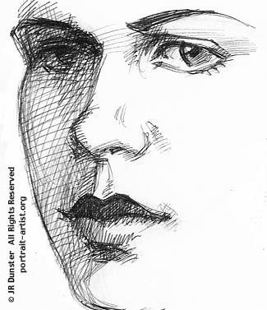
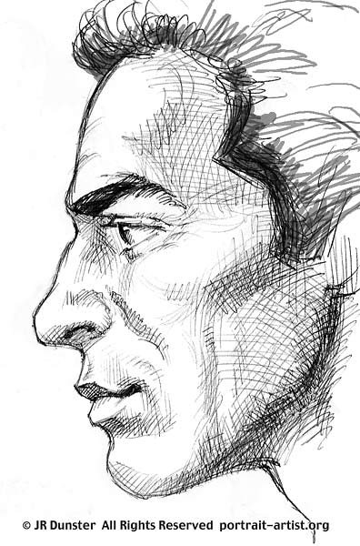
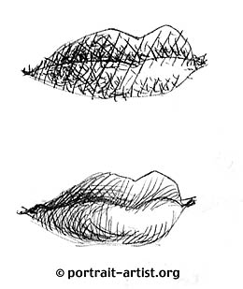
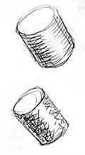
Motivation

Slide 3
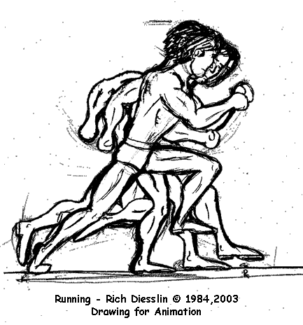
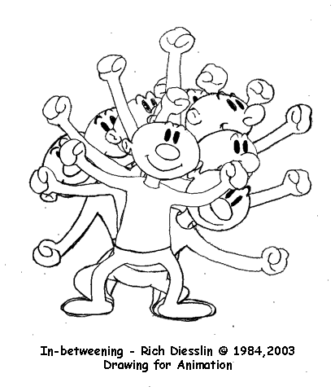
Application: In-betweening

Slide 4
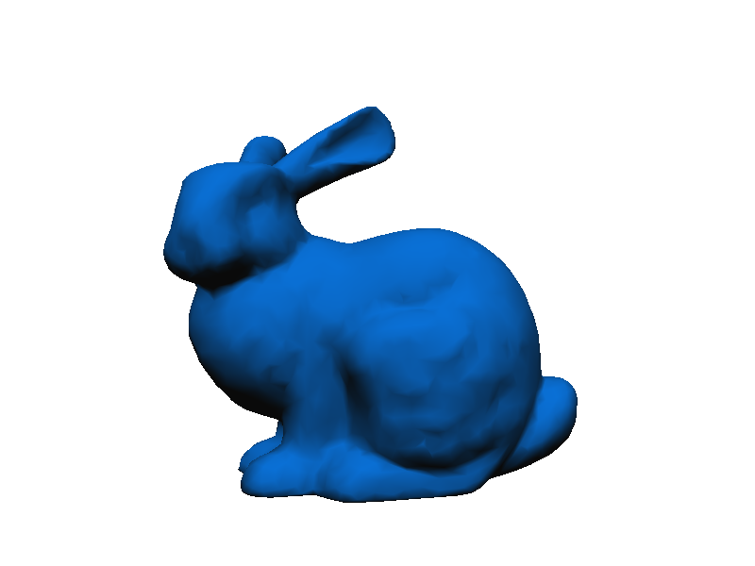
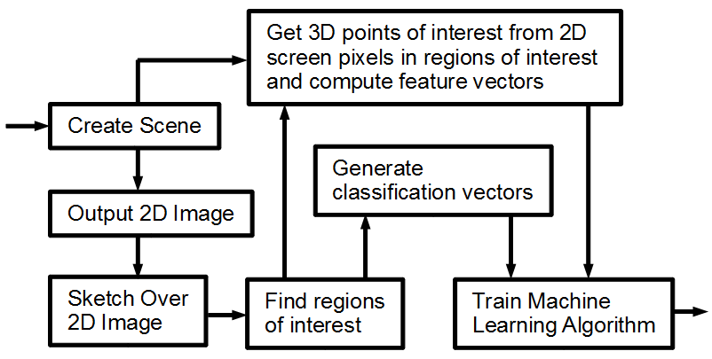
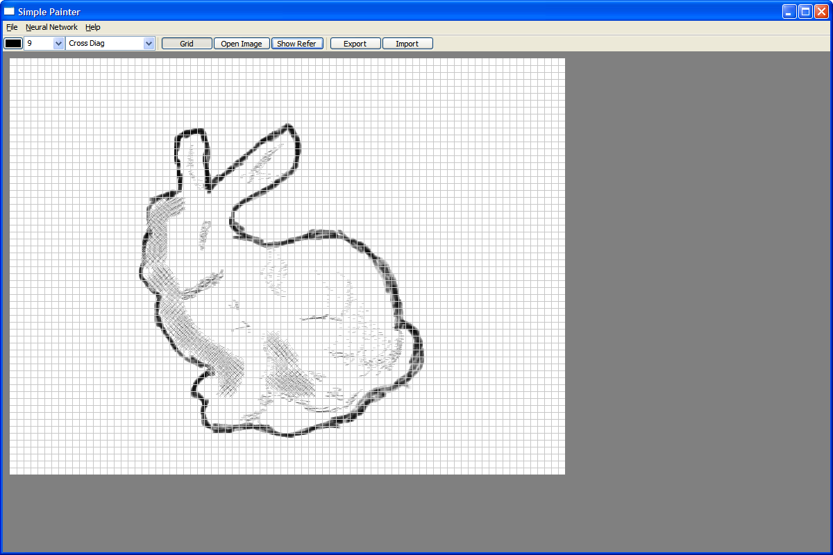
Pipeline

Slide 5
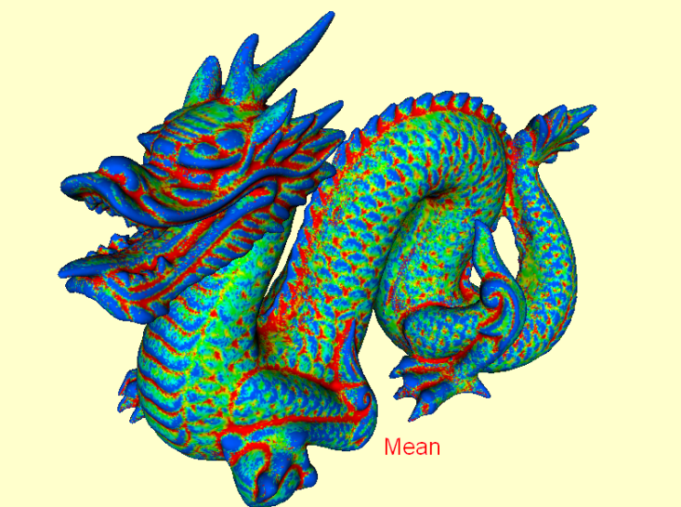
Feature Vector
Diffuse component
Distance from camera
Mean curvature
Distance to closest edge
Is the closest edge a silhouette edge?

Slide 6
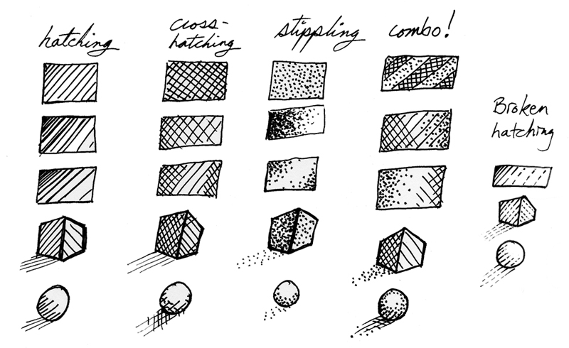
Classification Vector
Intensity
Brush Size
Brush direction
Brush Type
Solid
Line – uses mouse velocity to determine hatching
Diagonals (forward, backword, cross)
Stripes (horizontal, vertical)
Cross
Image from: http://bradalbright.blogspot.com/

Slide 7
Learning Algorithms
Neural Network (3 layers, 13-15 hidden neurons)
kNN (5 neighbors)

Slide 8
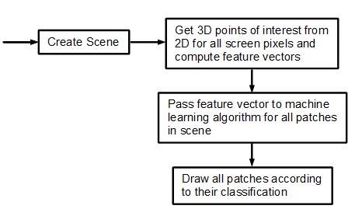
Synthesizing New Images

Slide 9
Results: Bunny Reference

Slide 10
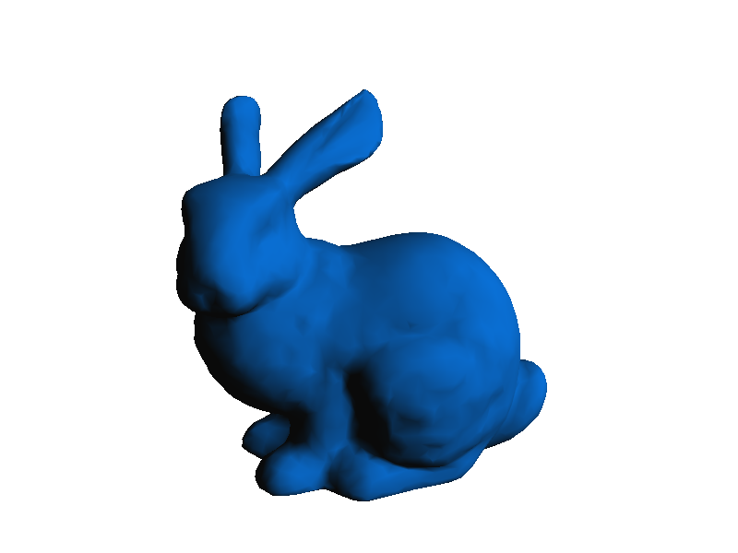
Bunny Synthesized

Slide 11
Applied to other shapes

Slide 12
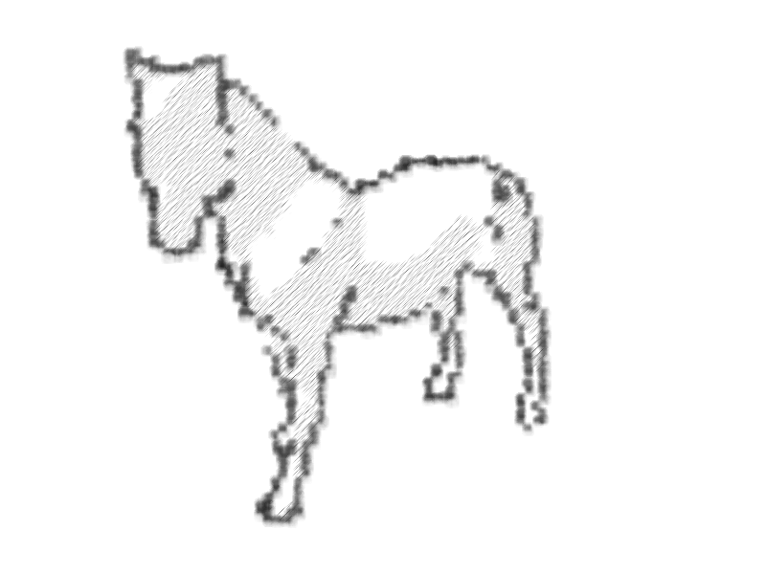
Applied to other shapes

Slide 13
Capturing different styles

Slide 14
Style comparison

Slide 15
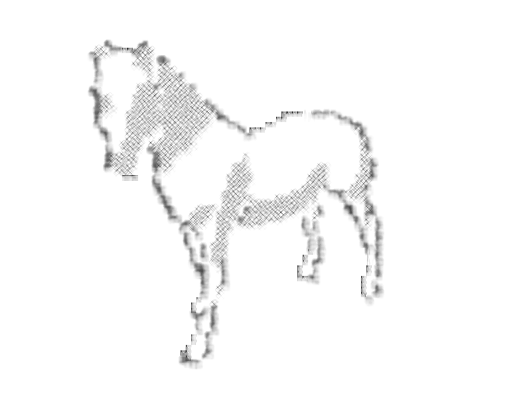
Style Comparison

Slide 16
Neural networks vs. kNN

Slide 17
Neural networks vs. kNN

Slide 18
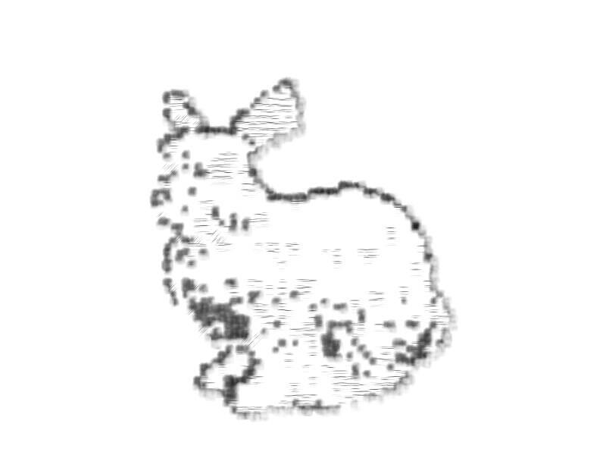
kNN: Number of neighbors

Slide 19
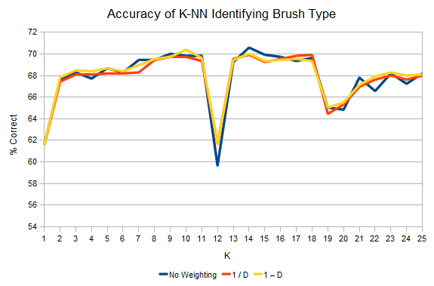
Accuracy on training data

Slide 20
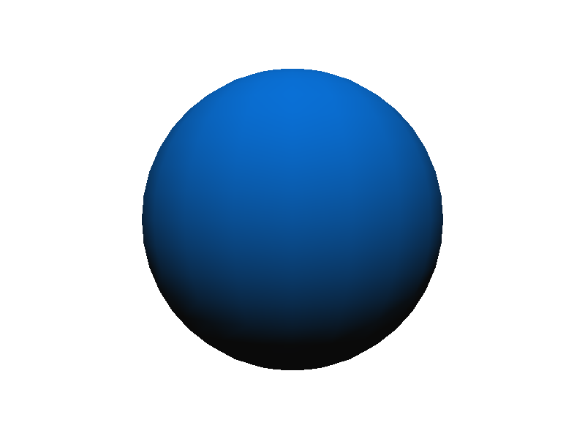
The not-so-good results

Slide 21
The not-so-good results

Slide 22
Conclusion
Successful synthesis of images after learning the style of an artist
Neural networks produce more consistent results compared kNN

Slide 23
Questions?
Thank you for coming to the last day of talks!

